Slide 1
Diagnosing Well
This presentation will cover:
Mental Capacity
Advance Decisions to Refuse Treatment (ADRT)
Life Sustaining Treatment
Making a Will

Slide 2
Scenario: Fred and Mary

Slide 3
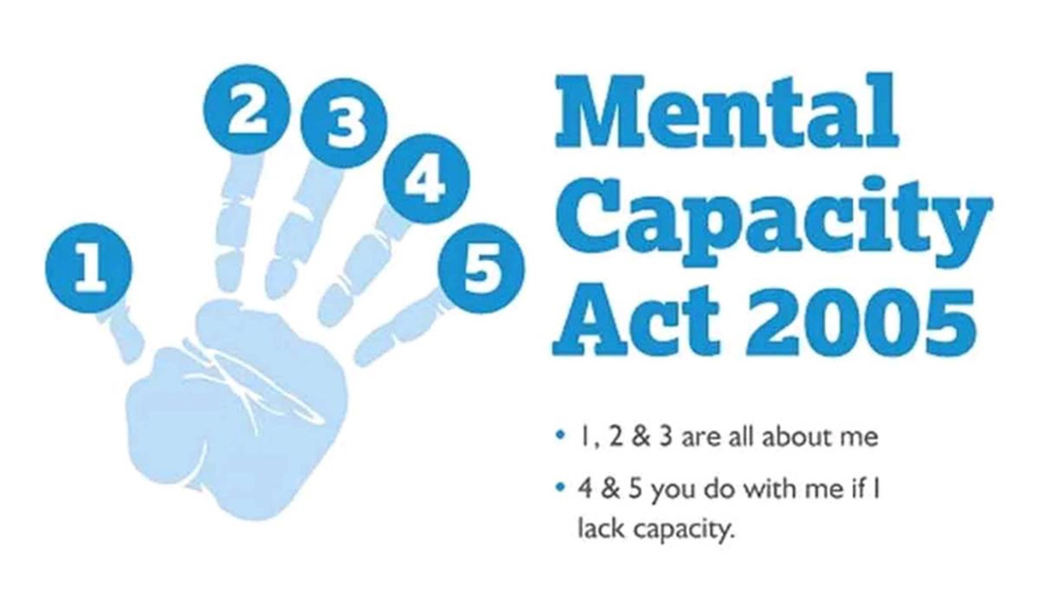
Mental Capacity- What is it and why does it matter?
Mental Capacity refers to an individual making their own decisions.
That means that Fred can make his own decisions about his money, health, and treatment without any help from his wife
Mary or anyone else.

Slide 4
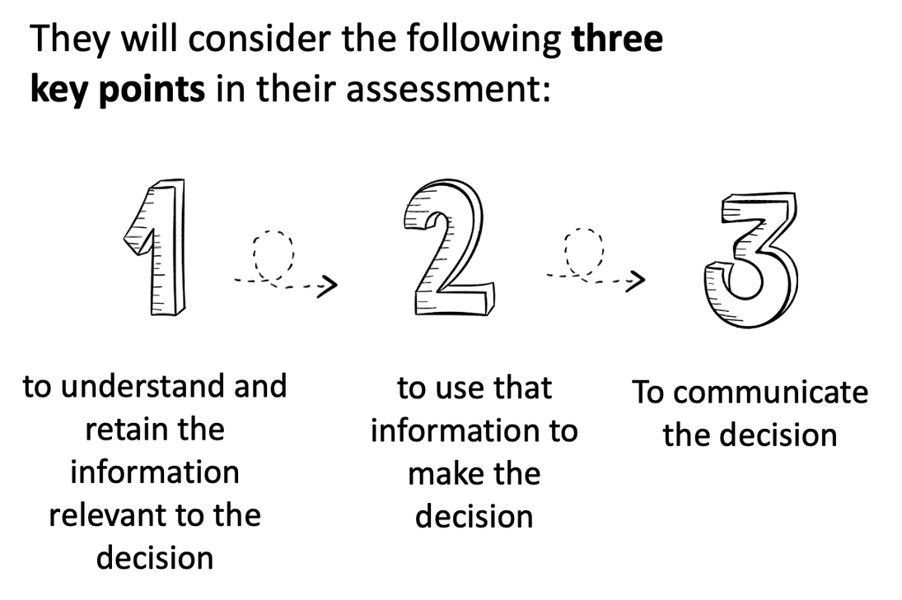
Capacity Assessments-
What is a formal capacity assessment and when is it done?
You may need to assess capacity where a person is unable to make a particular decision at a particular time because their mind is affected by illness or disability.
Formal capacity assessments are normally carried out by a qualified nurse, therapist, etc.

Slide 5
Applying Formal Capacity Assesments to Fred and Mary's situation
Fred is looking to draft a Will but is struggling to retain information for longer than an hour at a time. Fred understands what a Will is but is unsure about how much money he has in savings and doesn’t understand the details of drafting a Will.
He meets with his solicitor to discuss the Will and for the next hour the solicitor explains all the details which he is mostly able to retain, but he does need some assistance from Mary when it comes to specifics.
Despite this, Fred does have sufficient capacity to draft a will as he understands the information and can use it to make decisions regarding beneficiaries and the division of assests.

Slide 6
Advance Decisions to Refuse Treatment (ADRTs)
1
2
3
ADRT CANNOT BE USED TO REQUEST MEDICALLY ASSISTED DEATH (EUTHANASIA)
METHOD OF PLANNING AHEAD AT A TIME THE ADULT HAS CAPACITY
REFERRED TO AS A LIVING WILL

Slide 7
Advantages
Disadvantages
Certainty
Invalid if circumstances change
Legally Binding
Informally created
Needs to be specific- cannot make a generalized ADRT
Easy to create- can be
done on the following website- www.mydecisions.org.uk
No central register- carrying a card can be useful

Slide 8
Fred making an Advance Decision to Refuse Treatment
Fred is also a Jehovah's witness, and does not consent to receiving a blood transfusion. As he sometimes gets confused in stressful situations such as getting admitted to hospital, he decides to make an ADRT to refuse any blood transfusions if he gets admitted to hospital in the future.

Slide 9
Must be in writing
1
ADRTs- Life Sustaining Treatment
Signed by the maker
2
Signature must be witnessed
3
4
Must specify that the decision applies "even if life is at risk"

Slide 10
You can refuse a treatment that could potentially keep you alive, known as life-sustaining treatment.
ADRTs- Life Sustaining Treatment
This is a treatment that replaces or supports ailing bodily functions, such as:
ventilation – this may be used if you cannot breathe by yourself
cardiopulmonary resuscitation (CPR) – this may be used if your heart stops
antibiotics – antibiotics can be life sustaining in treatable pneumonia or can be a comfort measure for terminally ill patients with purulent sputum.

Slide 11
Why Should I make a Will?
I have control over who administers my estate
I can leave my assets to the people I care about
I can benefit from tax relief
I can avoid disputes between family members after my death

Slide 12
Scenario: Fred Making a will
Fred has early on-set dementia. He wishes to make a Will but has poor short-term memory and struggles to retain new information for more than about an hour. A solicitor meets with him to discuss the Will. Fred knows what a Will is but does not realise the size of his estate. The solicitor explains the details of the decision orally and in writing.
Does Fred have capacity to create the Will?

Slide 13
Supporting
Well

Slide 14
Why Create an LPA?
PEACE OF MIND
TIME
CHOICE
CONTROL
COST

Slide 15
What is a LPA?
A Lasting Power of Attorney is a legal document which allows you to appoint an individual or a group of individuals to make decisions on your behalf.

Slide 16
Lasting Power of Attorney
LP1F
LP1H
PROPERTY AND FINANCIAL
HEALTH
AND
WELFARE

Slide 17
LP1F
e.g. Insuring, Maintaining and Repairing Property

Slide 18
LP1F
Managing Bank Accounts, Income and Bills

Slide 19
LP1H
Consenting to medical treatment and arranging community care

Slide 20
LP1H
e.g. Deciding what I wear, where I live and what leisure activities I take part in

Slide 21
Scenario: Fred and Mary
After recently being diagnosed with dementia Fred wants to know his finances and medical treatment will be overseen by someone he trusts. His nurse has advised him informally that she believes he still has capacity to create an LPA, however he will need to get a signed form confirming this.
What should Fred's next steps be?

Slide 22
WHAT YOU MUST UNDERSTAND BEFORE MAKING AN LPA
1
What an LPA is
2
Why you want to make it
3
Who you are appointing
4
Why you have selected them
5
What powers you are giving

Slide 23
Completing the Application
DOCUMENTS
NAMING PERSONS
PAY THE FEE
SEND THE APPLICATION

Slide 24
Do I need a solicitor?
1
2
3
Am I confident I can fill out each form correctly?
Am I concerned someone will challenge the validity of the LPA?
Can I commit the time to completing the documents?

Slide 25
Attorney Role
Joint
or Several
Payment
Replacement

Slide 26
Revoking an LPA while you still retain capacity
Who the attorney currently is
What authority the attorney has
Why it is necessary or expedient to revoke the power
The foreseeable consequences of revoking the power
The reasons for the original decision to appoint the attorney

Slide 27
Scenario: Fred and Mary
Fred has not appointed a lasting power of attorney and no longer has the capacity to make decisions about his finances.
Mary would like to help make decisions on Fred's behalf to keep his finances safe and make purchases on behalf of Fred to meet his needs.
What should Mary's next steps be?

Slide 28
Deputyship
This is an Order of the Court of Protection.
Similar to an LPA appoints a person or persons to deal with the affairs of an individual who has lost mental capacity to deal with their own affairs.
A Deputyship Order can be made in respect of property & financial affairs, or , less commonly health & welfare.

Slide 29
Thank You
for Listening

Slide 30
Living
Well

Slide 31
The Care Act 2014

Slide 32
Needs Assessment:
Care Act Section 9
Whether providing care and support can help achieve those desired outcomes
Needs for
care and support
The outcomes in day-to-day life
How those needs impact well-being
Duty of local authority
TO ASSESS

Slide 33
CARERS ASSESSMENT
Aim of an assessment is to establish:
Carer's needs for support
How sustainable your caring role is
Support plan to meet your eligible needs
Outcomes you want to achieve and the impact of caring on those outcomes

Slide 34
2
1
Identifying your Eligible Carer Needs
3
Identifying All Your Carer Needs
Support Plan to meet Eligible Needs
4
Financing the Support Plan
Assessing Carer Needs

Slide 35
Challenging decisions
1
2
3
Complaints against
Social Services
Local Government and
Social Care Ombudsman
Judicial Review

Slide 36
Funding
01
04
Public Funding
Self Funding
02
05
Personal Budget
Deferred Payments
03
Direct Payment

Slide 37
LOCAL AUTHORITY CANNOT CHARGE FOR:
01
02
Immediate care services aimed at freeing up acute hospital beds
After-care provided under Mental Health Act s117
03
04
Community equipment up to £1,000
e.g. mobility aids
Any service which the NHS is under a duty to provide

Slide 38
Example

Slide 39
Needing Support
Fred and Mary are 63 and 68 years old respectively and live together at home. She is employed part time as an accountant; he has dementia.
Usually Fred goes to a day service for 7 hours a day for the 3 days that his wife is at work. The rest of the time she looks after him apart from one weekend a month when he stays at a care home to give Mary some respite.

Slide 40
During the pandemic she has been working from home. The day service closed and the care home would require Fred to isolate in the bedroom for 14 days if he stayed there so they did not use it. As a result, the caring demands on Mary have become significant and she does not know what to do.
She decides to phone the local authority to ask about a carer's assessment. Over the next 4 weeks, a social care support officer assesses the couple's needs.

Slide 41
In relation to Mary
Assessed needs
Without support,
Her employment is at risk
She is not sleeping well which may require medication
The relationship between them them is becoming fraught
She feels exhausted all the time...
Eligible Needs
Clear risk of physical/mental deterioration
Unable to provide care to Fred, maintain a habitable home environment, engage in work, engage in recreational activities.
As a result, significant impact on her wellbeing

Slide 42
Support Plan: He needs
Someone to care for Fred for 4 hours a day so she can do her accountancy
Someone to care for Fred for an extra 3 hours, twice per week so she can take part in leisure activities
Advice about requesting flexible working with her employer
Support to use online food delivery services
Financing the Plan
The couple's finances are above the threshold (currently set at £23,250) for local authority commissioned services. But with the help of a social worker, organisations are identified at reasonable rates to arrange the paid carers. The local authority arranges for the employment advice and food delivery support to be freely provided to Mary.

Slide 43
Thank you

Slide 44
Dying Well
Part Four of the 'Well Pathway for Dementia'

Slide 45
Overview
Best Interests
Human Rights
End of Life Treatment

Slide 46
1 | No legal definition but the MCA 2005 provides a checklist of factors
2 | Consider all relevant circumstances
3 | Will capacity be regained?
4 | Encourage participation
5 | Consider wishes, feelings, beliefs and values
6 | Consult with experts
What are
best interests?

Slide 47
Scenario: Fred and Mary
The couple want to start thinking of the future, when Fred's health seriously starts to deteriorate.
They want to think about these issues now and consider what the options might be.
How does Fred and Mary go about making these best interest decisions?

Slide 48
Step One : What Choices are available?
What care and support is available at home?
What support are my carers entitled to?
If I am self-funding, should we spend the money on paid home support?
If I am entitled to state-funding, what services will be offered and by who?

Slide 49
Who makes these best interest decisions?
Family Members
Local Authority
Court of Protection appointed Deputy
Those with Lasting Power of Attorney
Healthcare Professionals

Slide 50
1 | Decide together
2 | Consult with others
3 | Consider their wishes
4 | What would they have chosen?
How are the wishes and feelings of the person taken into account?

Slide 51
"NEXT OF KIN"
01
First point of contact in an emergency
02
No legal definition and next of kin are given no legal rights and responsibilities
03
04
If you want your relatives to make best interest decisions, an LPA will need to be created
Health or social care professionals may make best interests decisions (following the checklist) if there is no LPA

Slide 52
Consult with Others
Health and Welfare
LPA
Best Interest Meetings
Examine pros and cons
of each option

Slide 53
The Person Living With Dementia has the right to choose their accommodation provider if:
The accommodation provider
is willing to provide care
Accommodation is
available
Within the personal budget
The accommodation
is suitable

Slide 54
Clearly identify options
Disputes
Look at advantages and disadvantages of each option
Independent Mental Capacity Advocate (IMCA)

Slide 55
SERIOUS DISPUTES
01
Involve significant welfare issues
02
Experts may help
03
04
Court Mediation Pilot
Unresolvable disputes will go through the Court of Protection

Slide 56
Human
Rights Act
1998

Slide 57
Article 5 ECHR : Right to Liberty
If, because of dementia, you lack capacity to decide your own care arrangements and are moved into a care home in your best interests, this may be regarded as a deprivation of liberty

Slide 58
Article 5 ECHR : Right to Liberty
Those living in care homes are entitled to safeguards including:
A Representative
Independent Assessments
Free Legal Aid to challenge the arrangements
Access to a Judge in the Court of Protection

Slide 59
Article 8 ECHR :
Right to respect for private and family life
Are interferences with private and family life necessary and proportionate?

Slide 60
Article 8 ECHR :
Right to respect for private and family life
Areas where Article 8 rights could be challenged:
Care arrangements impacting on family life
DNAR decisions
Maintaining family contact
Involving family in best interests decisions

Slide 61
End of Life
Treatment

Slide 62
The ReSPECT Plan
Ensures right care is given in an anticipated future emergency
Capacity is no longer there
Speak to Healthcare Professionals
Record

Slide 63
Cardiopulmonary Resuscitation (CPR)
CPR is an attempt to restart a person's heart if they have a cardiac arrest

Slide 64
DNACPR
01
02
"do not attempt cardiopulmonary resuscitation"
Created by healthcare professionals to record the view CPR should not be attempted
03
04
Medics may attempt resuscitation
A DNACPR is not legally binding

Slide 65
1 | If there is no DNACPR, there is presumption for CPR
2 | A person with capacity to decide on treatment must be consulted with about the issue (Article 8)
3 | If person lacks such capacity, a welfare attorney or deputy (if there is one) or anyone with an interest in the person's welfare should be consulted about the DNACPR decisions (Article 8)
4 | Neither a welfare attorney or deputy can demand treatment
Resuscitation Council Guidance

Slide 66
Thank You
for Listening

